Slide 1
https://www.storydoc.com/f2643301b1e73e64139dba6128275fb6/162feff1-4f46-49f8-9299-338a57611e5a/672df315fb98db8723d9082f

Slide 2


INFOSYS SPRINTBOARD
INFOSYS SPRINGBOARD
MR. VAMSI (Trainer)

Slide 3


Slide 4
WHY POWER BI
Data Integration
Predictive Analytics
User-Friendly Interface
Drag-and-Drop Features
Time-Series Analysis6. Collaboration
Cost-Effectiveness
Customization and Extensibility
DAX (Data Analysis Expressions)
Custom Visuals
Scalability

Slide 5


Slide 6
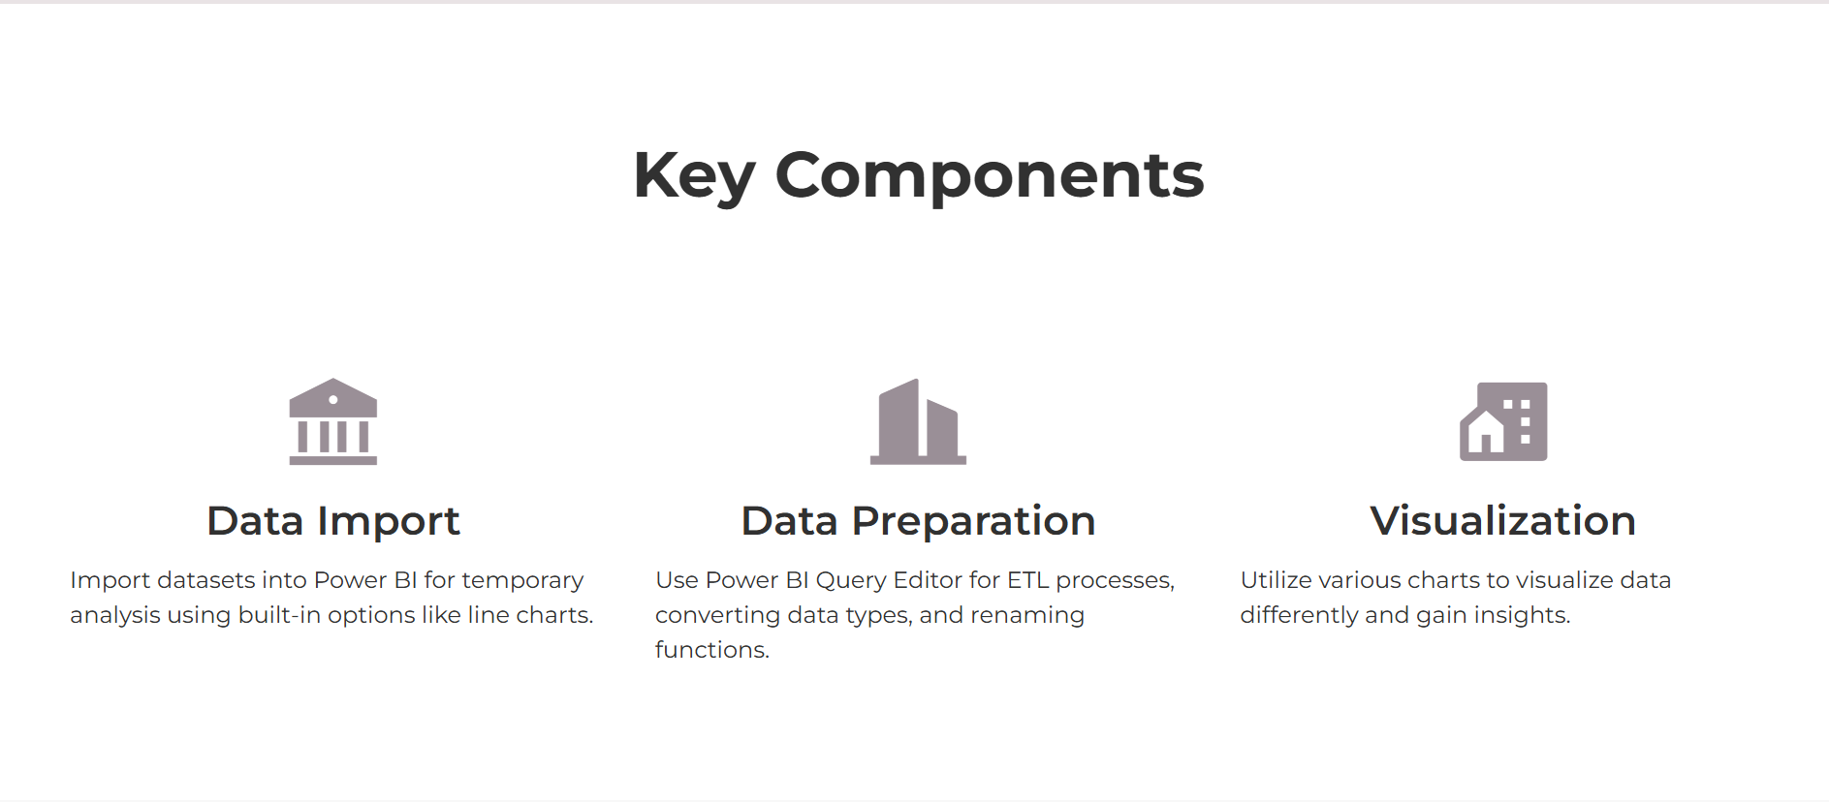
POWER BI IMPLEMENTATION PHASES

Slide 7
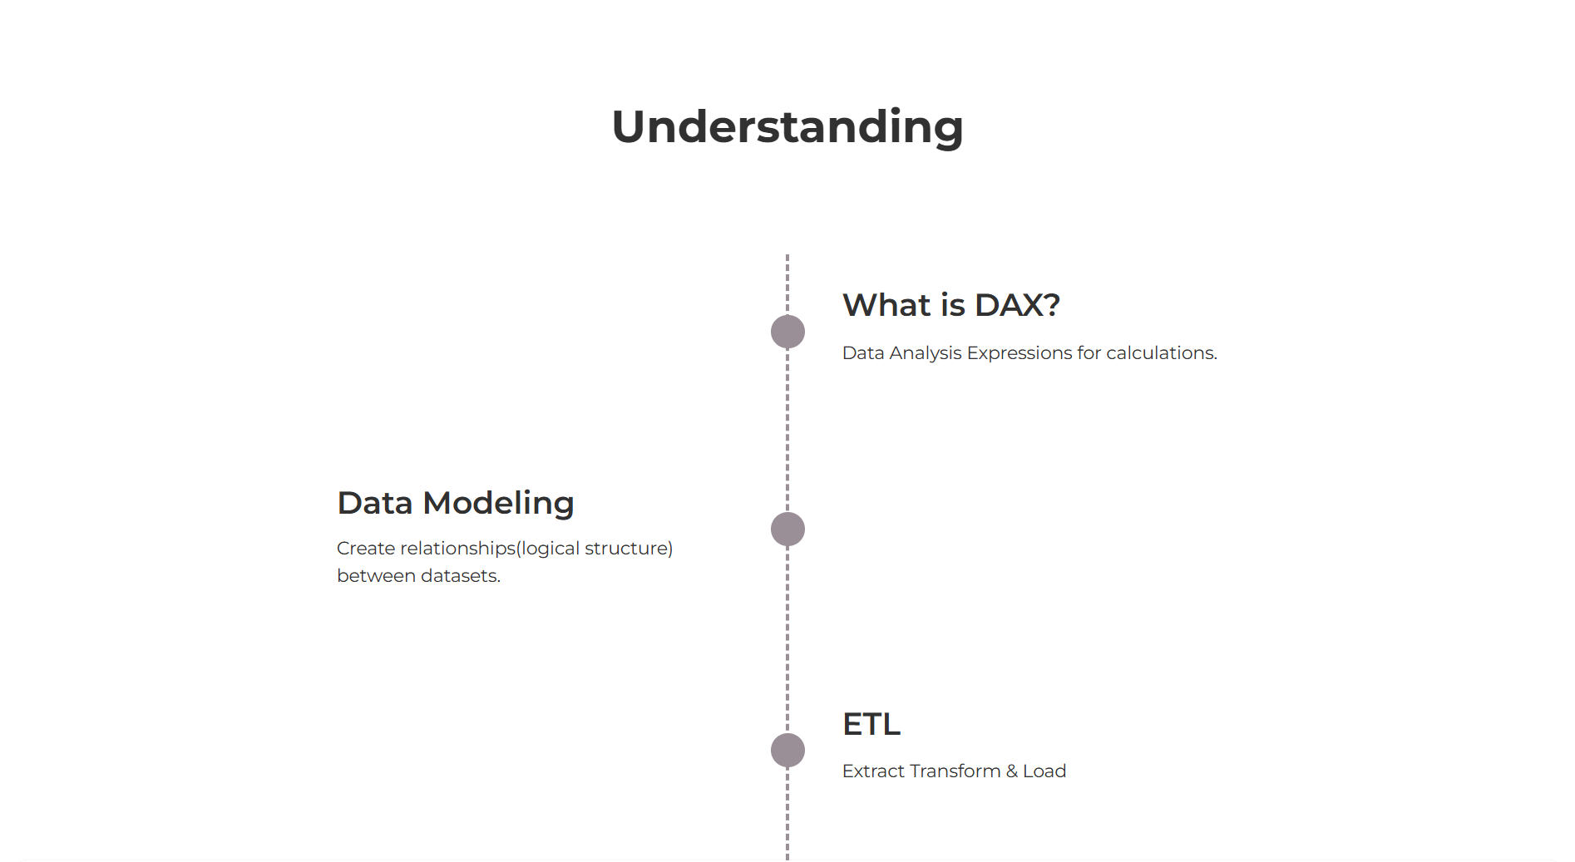

Slide 8
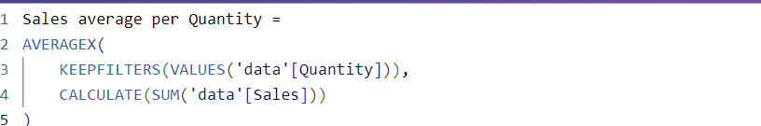

DAX Query

Slide 9
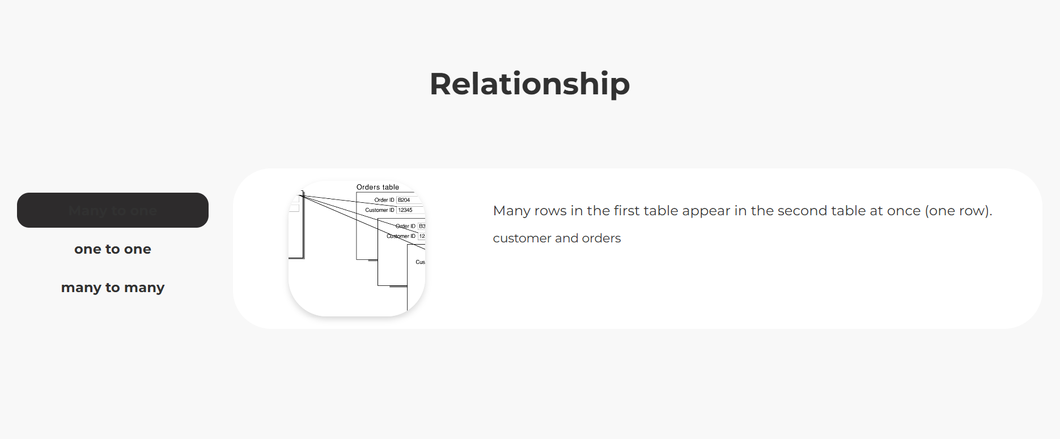

Slide 10
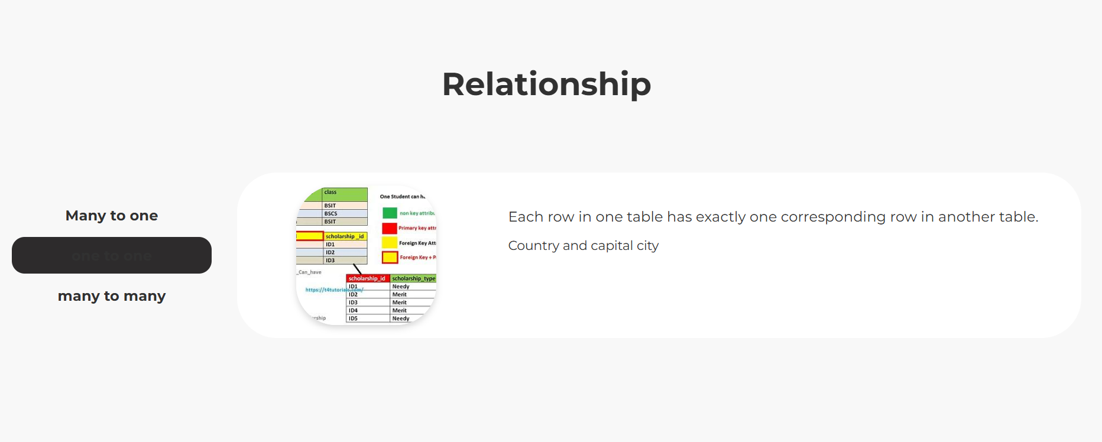

Slide 11
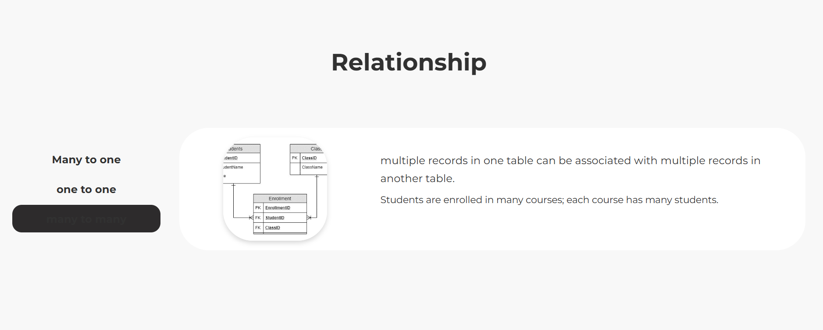

Slide 12
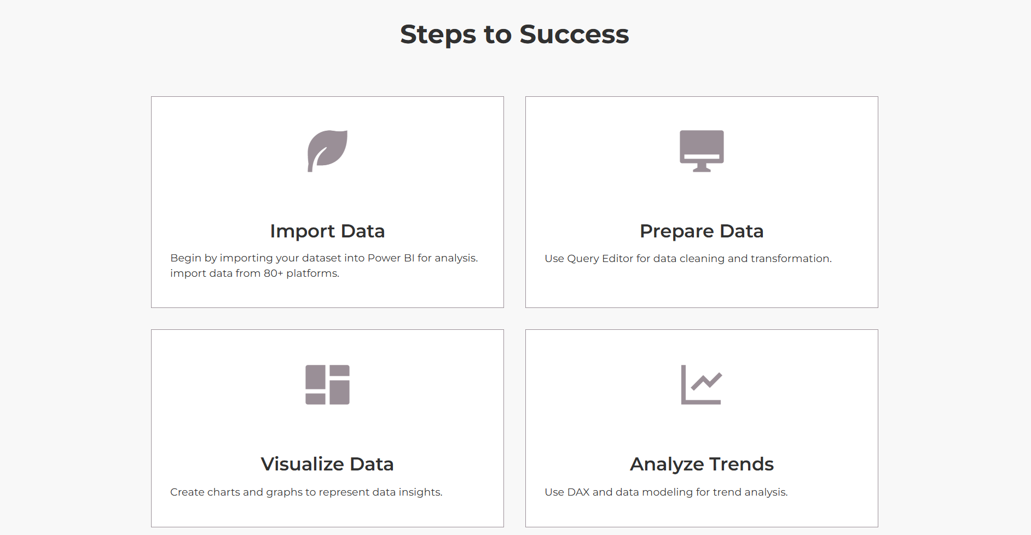

Slide 13
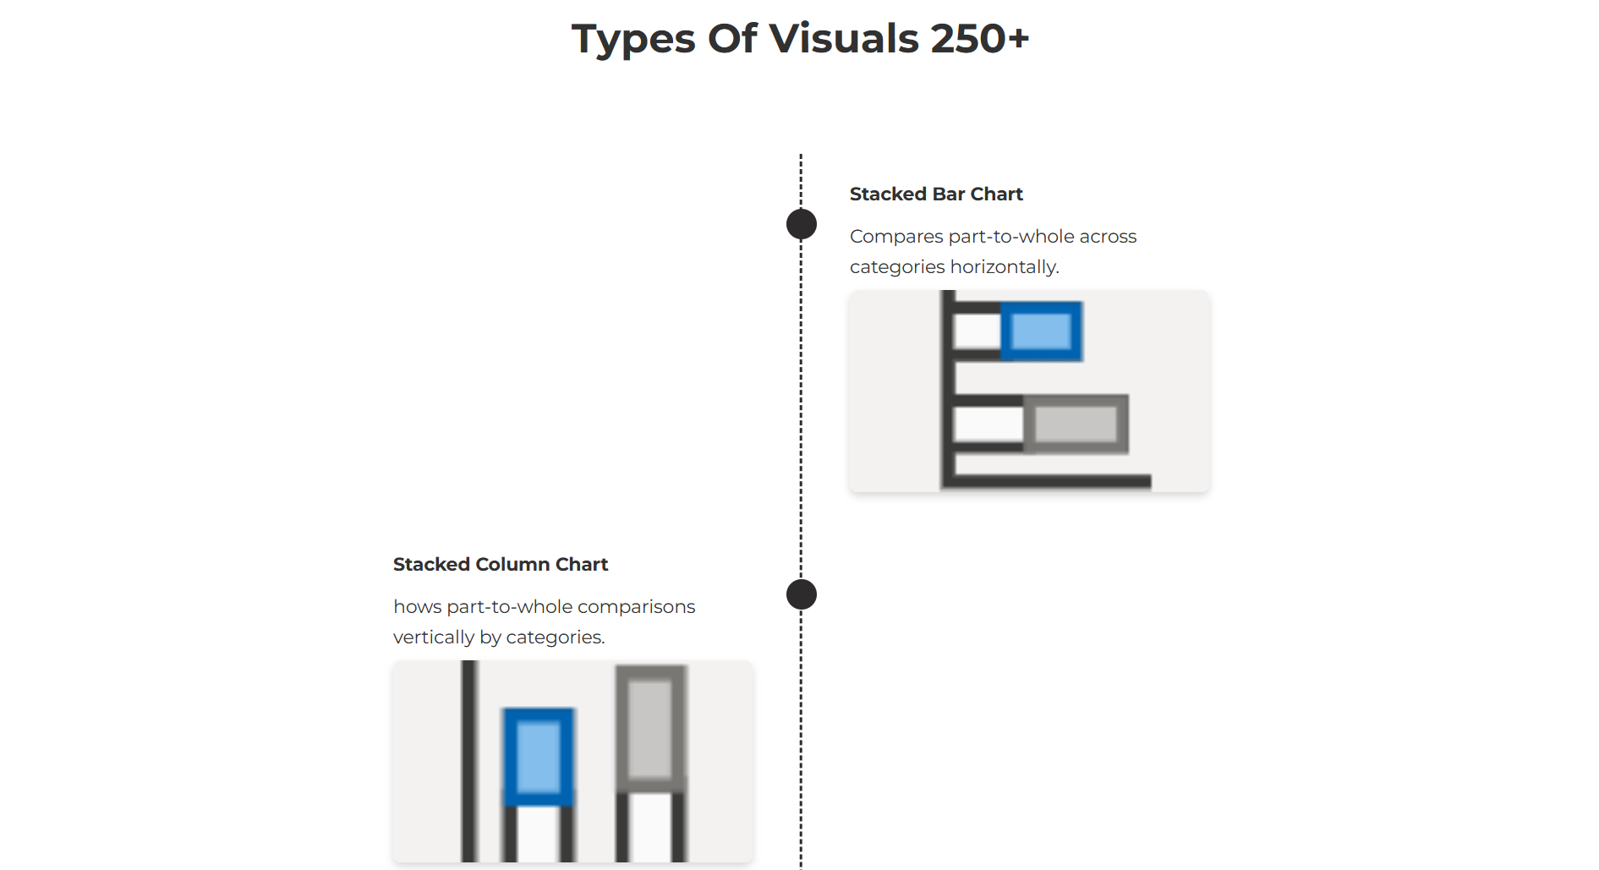

Slide 14
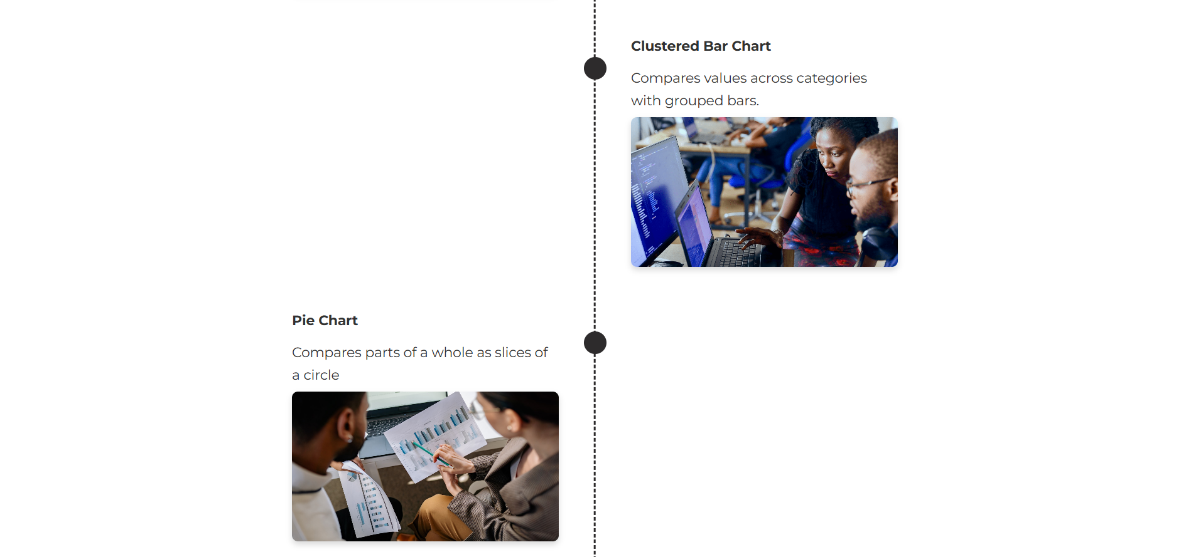



Slide 15
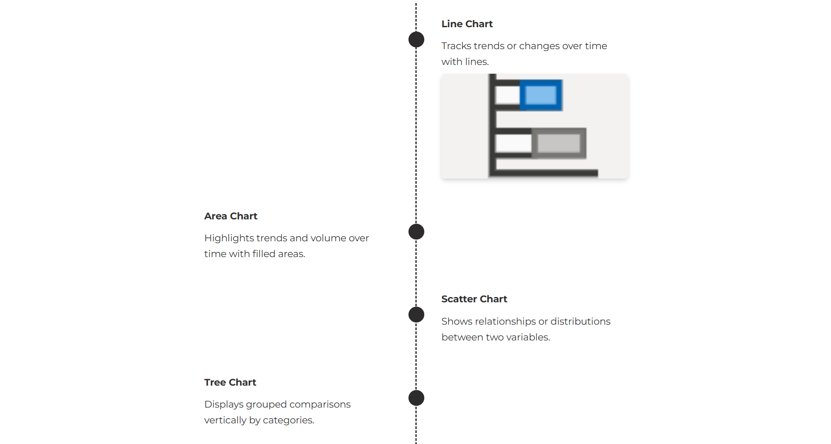




Slide 16
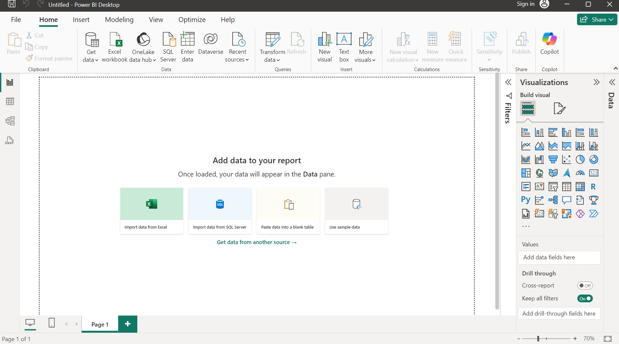
Power BI Desktop

Slide 17
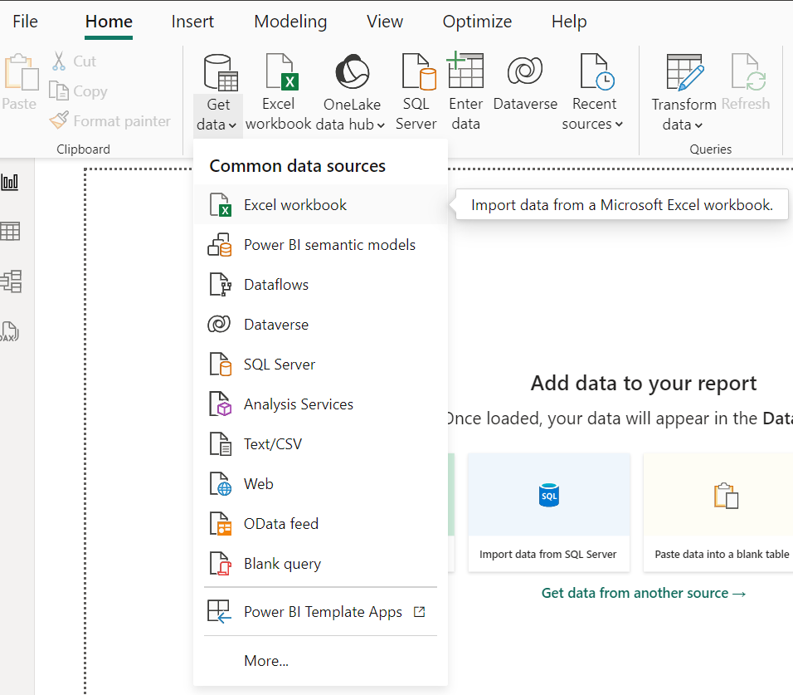
Data Import

Slide 18
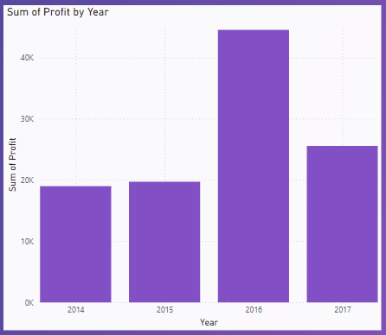
VISULAIZATION
The bar chart displays the Sum of Profit by Year from 2014 to 2017.
A noticeable peak in profits is observed in 2016, significantly outperforming the other years.
While 2015 shows a slight increase compared to 2014, profits drop again in 2017.
This trend could indicate external factors like market conditions or internal business decisions driving the profit spike in 2016.

Slide 19
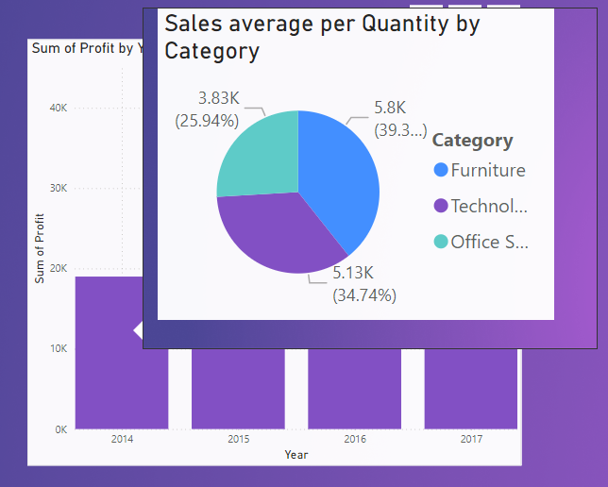
Detail view using ToolTips

Slide 20
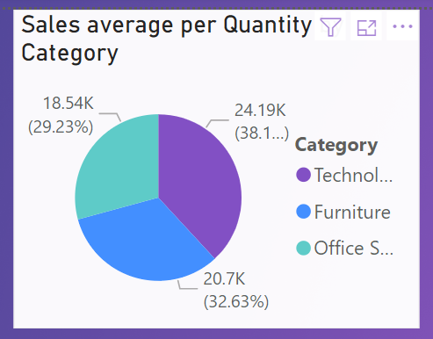
The pie chart represents the Sales Average per Quantity by Category:
Technology accounts for the largest share at 38.1% (24.19K), indicating it is the top-performing category in terms of sales average.
Furniture follows with 32.63% (20.7K), making it a significant contributor to sales.
Office Supplies represents the smallest share at 29.23% (18.54K), suggesting potential areas for growth or focus.

Slide 21
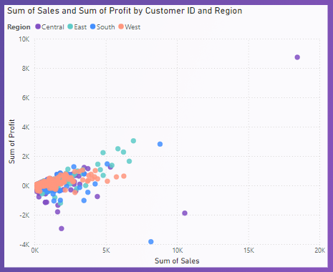
The scatter plot shows the Sum of Sales vs. Sum of Profit segmented by Customer ID and Region:
Most data points are clustered near the lower range of sales and profits, indicating many customers contribute to smaller sales and profit margins.
A few outliers, particularly in the East and West regions, show significantly higher sales and profits, likely representing key customers driving revenue.
Negative profits for some data points in all regions suggest losses despite achieving sales, pointing to potential inefficiencies or pricing issues.

Slide 22
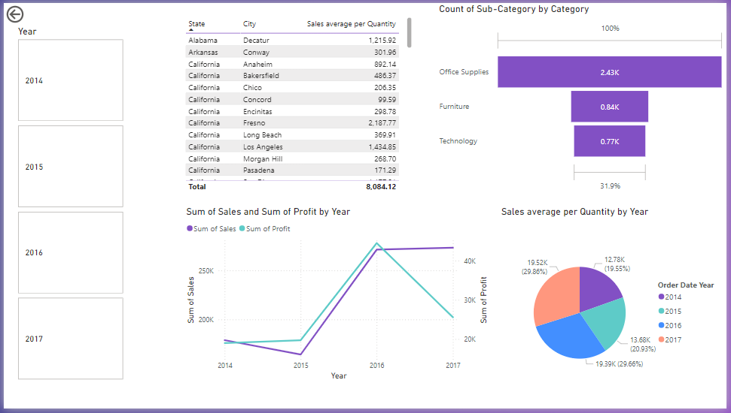
Sales and Profit Trends (Line Chart):
The sum of sales and profits increased significantly from 2014 to 2016, peaking in 2016.
A decline in sales and profit is evident in 2017.
Sales Average per Quantity by Year (Pie Chart):
The highest average sales per quantity occurred in 2014 (29.86%) and 2016 (29.66%).
2017 contributed the lowest average sales per quantity (19.55%).
Category Breakdown (Bar Chart):
Office Supplies dominated with the highest count (2.43K), followed by Furniture (0.84K) and Technology (0.77K).
This highlights Office Supplies as a major contributor to sales activity.
Geographical Sales Insights (Table)
Interactivity (Filter by Year)

Slide 23


Slide 24


Slide 25


